Slide 1
This powerpoint presentation contains quotes covered by copyright laws and is for personal use only and not to be copied or distributed.

Slide 2



To create a safe space where individuals encounter God's truth and grace, allowing them to heal, grow and walk confidently in their God-given purpose, identity and in His unwavering love. www.emeraldpathway.org

Slide 3
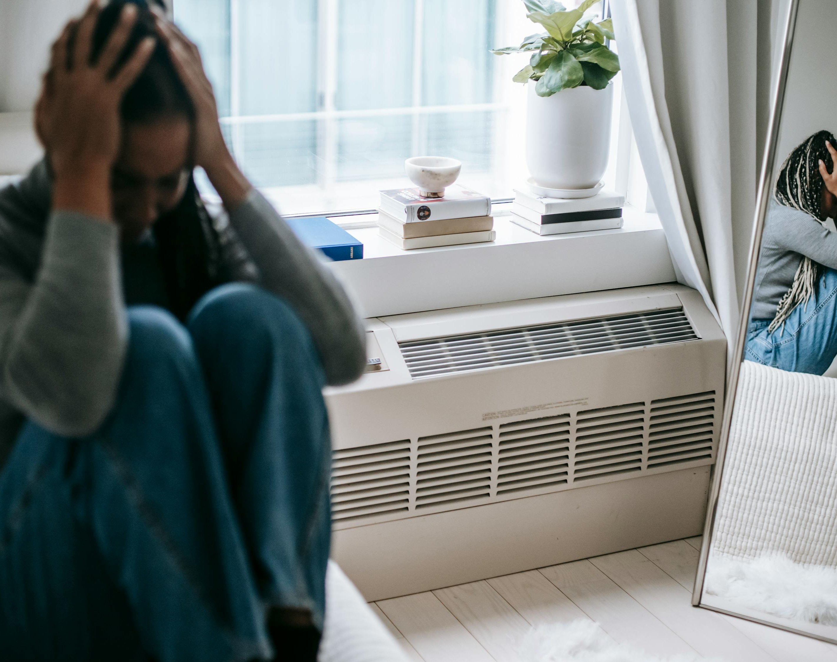
Difficult Relationships
What makes them difficult?
Why is an encounter so difficult to get past?
What is my part in making a relationship difficult.

Slide 4
1 John 4:18&19
18. Love never brings fear, for fear is always related to punishment. But love’s perfection drives the fear of punishment far from our hearts. Whoever walks constantly afraid of punishment has not reached love’s perfection.
19. Our love for others is our grateful response to the love God first demonstrated to us.
None of us were raised by perfect parents and no matter how much we tried WE were not perfect parents.
We look to people to meet our emotional needs. God created core longings within us to draw us to HIM because He is the only one who can meet those needs.

Slide 5
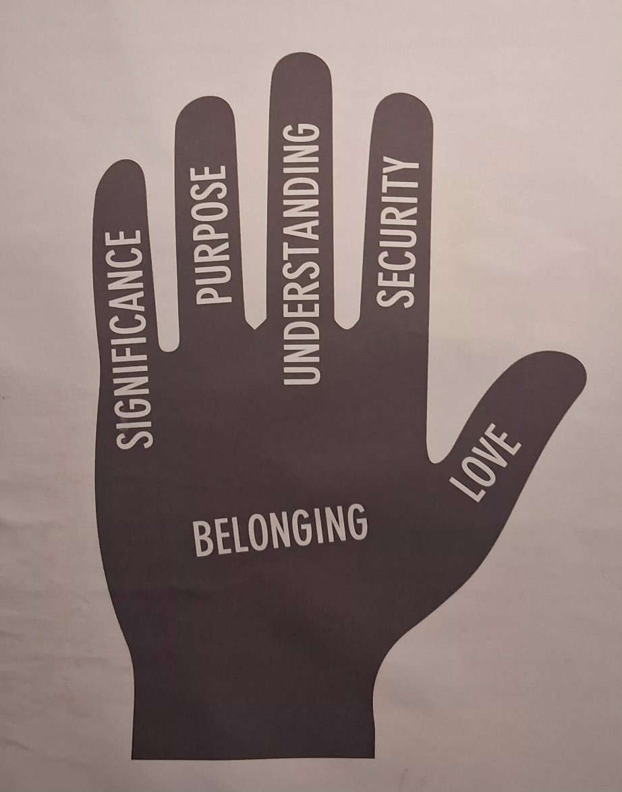
What makes a relationship complicated?
Introduction to our 6 Core Longings authored by Dr. Anne Halley
Significance
Purpose
Understanding
Security
Love
Belonging

Slide 6
Significance
Significance: The freedom that comes from being delighted in and important because of being who I am. I do nothing to earn this; it is how I feel while I’m with you. Significance is solely connected to the reality that God designed me and assigned worth to my existence. I am significant simply because I am a child of God. Our true significance is found in God, being created by God, and then God assigning worth to me. It is not defined by me or by others. Only God is allowed to define me, not even me!

Slide 7
Purposer
Purpose: Purpose is about having a relationship with God and others, experiencing their love for me and responding to their love. We long for purpose. It is the feeling of knowing we are important to another. We want to know where we can put our oar in the water and make contributions that matter to the larger whole. We want to find our unique fit in the larger story going on around us. There will never be another me, and no one can love God or the others in my life in exactly the way I can. My love is purposeful and God’s love for me is my purpose. My gifts and talents are simply part of my design in being made in the image of God. My purpose is NOT informed by what I am good at or what I can do in this world, other or “for God”.
While we enjoy putting our “oar in the water” our purpose is to love God and to be loved by HIM!

Slide 8
Understanding
Understanding: We want to be seen, known, and understood in our uniqueness. We want our inner experiences and feelings, our drives, our dreams, our desires, our hopes, our gifts, talents, and potential to be understood. We also need to be understood in our pain, confusion, and brokenness. We need another to lovingly explore and understand, along with us, what is beneath the surface of our lives. God understands my thoughts and feelings as well as deeply hidden motives and defenses.
Refer back to 1 John 4:19 “Our love for others is our grateful response to the love God first demonstrated to us.”
If wounded in community we must be healed in community and yet only God completely understands me.

Slide 9
Security
Safety/Security: We need more than physical safety; we need emotional safety. We need the safety to grow and learn over time, making mistakes along the way. We need safety that allows fragile, hidden, or unexplored parts to be uncovered without fear of punishment, ridicule, or judgment. It is the felt confidence that I do not have to hide or feel shame and that my needs are important and will be met. Being taken into HIs shelter gives me confidence I will not be left, abandoned, hurt or forgotten.
When we find this in God we are now free to be a safe place for others.

Slide 10
Love
Love: We long to be loved freely and unconditionally. Love is the continual attentiveness, acceptance, patience, nurture, and attention that we need. It is a foundational resource for our lives. We were made for love that is provided freely and unconditionally, not earned or withheld based on performance or behavior. God’s love is lavished even (and especially) when we don’t deserve it. Scripture describes us needing to have the roots of our lives go deep into this love, so it can continually fill us and free us to be who God intends us to be.

Slide 11
Belonging
Belonging: Is my felt place of being rooted, welcomed, and joined without any feeling of loss or fear. We long to know, deep within, that we are welcomed into and celebrated as an integral part of a larger family, the family of God. My home is in and with God where I experience nurture, empathy and hope that creates a sense of wellbeing. It creates a sense of community that tells us, “I am because you are.” We need to experience being welcomed and belonging as we are, which in turn supplies protection in any storm.
This is another way in which a faith community can be the hands and feet of God.

Slide 12
Trauma happens and harms us.
But I often wonder if the worst trauma is the second wave >
when your story is misbelieved, mistrusted, and maligned.
May your story find safe harbor
in the presence of people who will
honor both your vulnerability and resilience.
(Page 126 of “The Book of Common Courage” by K.J. Ramsey

Slide 13
What is my part in making it difficult.
It’s easy to see the log in the other person’s eye and hence do not look at the emotions behind our conclusions about the other.
As you review the six core longings the question should be, “What am I requiring of the person I am in relationship with? What do they seem to requiring of me?
Are you expecting them to meet needs that God wants you to look to Him to have met? People disappoint, God does not!
To look to others rather than to your relationship with God is, by definition, idolatry. “Blind or excessive devotion to something.”
Sometimes we don’t even realize the things we are turning to instead of God. Maybe it’s not others. It could be food, excessive exercise, drugs or alcohol, or excessive sleep. We call those dysfunctional behaviors.

Slide 14
Clenched Fist
1.An Uptight Fist
Shows up in People-pleasing (chameleon)
It is exhausting for others because the uptight person continually checking in by asking how you are or what you need from them.
Sadly, at the first sign of disconnect, the person runs away.
2. A Grabbing Fist
This person is emotionally dependent and clingy. They must do whatever you are doing in order to feel “all is good with the world”.
This person needs to know you will be what they need you to be.
It sets this person up for disappointment because you never know what is needed or expected of you.

Slide 15
3. Aggressive Fist
a. Demanding what he/she wants. Often their “wants” are unreasonable
b. Use blame, contempt or acts of punishment; in order to control.
c. Builds walls of protection, bitterness and resentfulness.
4. Resisting Fist
a. Due to a perceived failure ending in humiliation, ridicule or punishment, he/she become determined never to put yourself at risk of failure.
b. He/she resists change, challenge or anything that feels risky.
c. Insecurity breeds fear.
5. Controlling Fist
a. He/she keeps away from physical, emotional, or relational harm.
b. He/she try to control their life’s direction.
c. He/she have a gnawing fear that things might spin out of your control.
d. This may be because they were made to feel responsible for themselves & others.

Slide 16
Open Hands
Relaxed Hand
Weno longer look to people for deepest needs to be met.
We are confident in HIS acceptance.
While we enjoy affirmation from people, it is no longer a need.
Receiving Hands
We’re able to have relationships without unreasonable demands.
We Love without conditions or expectations, appreciating them for who they are.
We have freedom from anxious striving.

Slide 17
Hands that Give
With no agenda for receiving we are now able to give with a tender open hand.
We have an unending supply of love.
We no longer fear rejection when what we offer to someone is not enough.
Open to be Led
God doesn’t promise risk free, painless living.
God promises to supply all our needs in any circumstance.
Our open hand allows Him to lead.
Open Hand that Surrenders
Control is an illusion. Life involves risk and pain.
With complete surrender we will come to believe life is not being out of control but resting in His control and His love.
There is no joy outside of surrender.
You are on the path God calls holy.

Slide 18
How will all this information help? Discovering the driver of our emotions give us intel on moving that over to the God who cares.
When we can look honestly at what core longing is driving us, we are more likely to understand where the other person is coming from too. They have the same exact longings.
What are the facts? What have been your conclusions?
“In Numbers 13 the 12 spies all saw the same giants and knew the same facts. 10 felt like grasshoppers and said there would be no victory. Joshua and Caleb agreed the giants were big but believed they could prevail because “the giants were their bread.”
Same facts, different conclusions.
“Faith is not being in denial of the facts. It is having an ability to see the facts through the reality of God’s faithfulness and supernatural ability to perform what He has promised. Kingdom living is living in a new reality. Our new reality is that the natural realm is subject to the realm of God and His word.” (Victorious Emotions by Wendy Backlund)

Slide 19
Psalms 139:17&18 “Every single moment you are thinking of me!
How precious and wonderful to consider that you cherish me constantly in your every thought! O God, your desires toward me are more than the grains of sand on every shore!”
A measurement of what you truly believe about yourself and God: “When you fully believe that you are worthy to be loved, experiences of rejection will puzzle you, and your first thought will be that something must be wrong with the person rejecting you. When we become emotionally attached to truth, it will create a whole new emotional atmosphere in us. Our goal is to disempower emotions from being the gauge of whether something is true or not. Instead, let’s allow Holy Spirit to lead us into all truth.” (Victorious Emotions, Wendy Backlund)

Slide 20
Emotions should NOT be buried or stuffed. They are not a guide not a gauge for what is true.
Emotions are a messenger that tells us there is something we need to tend to. False beliefs or wounds will never heal if we do not tend to them.
Often our triggers expose our wounds and false beliefs. Then we chide ourselves for letting little things get to us rather than looking for the source of the trigger.
“Emotions do not validate truth; they validate what we believe. If we want to have different emotions, then we must have different beliefs that are based on God’s truth.”
Emotions can inform us, but they should not lead us. Emotions develop into beliefs which lead to conclusions. The reason the brain can use emotion to protect its conclusion, or belief is because most of us tend to use emotions to validate whether something is true or not.
“The best way to change our emotions is not by trying to get rid of them or to ignore them, but by focusing on building new, victorious ones by focusing on what the Word of God declares over us then allow ourselves to feel that truth.

Slide 21
Creating new neuropathways.
Our false beliefs have an emotional experience attached to an event which in turn creates a trigger.
Then the mind rehearses the false belief. The mind is always looking for (and finding) evidence that the false belief it holds is a valid belief.
Example: Your father forgets to pick you up from school and you felt abandoned and forgotten. We call God father therefore He will also forget me and abandon me. At this point an “orphan spirit” enter into the mix and the mind picks up on every example of someone praying and not receiving what they hoped for. This thinking becomes a well worn path in your mind.
In order to which to a new path one must, for instance, recite the core longing of safety/security enough times that your emotions inform your spirit it is true.

Slide 22
Triggers can be stubborn boogers. They can be buried under a pathway of thought and are sometimes difficult to dig out. It can’t just be an intellectual exercise so you may have to meet with Jesus in the way we do in prayer counseling.
If you find yourself unable to break away on your own, I invite you to look into: www.emeralpathway.org
There we can explore the difficult relationships and also sources of anxiety, depression, etc. including whatever clenched fist you find yourself leaning towards.
When it comes to difficult relationships we may find that the most difficult part is how we feel when we’re with them and the conclusions we come to when back home. Be open hearted to Holy Spirit and what she wants us to understand.

Slide 23
This powerpoint presentation contains quotes covered by copyright laws and is for personal use only and not to be copied or distributed.

